Slide 1
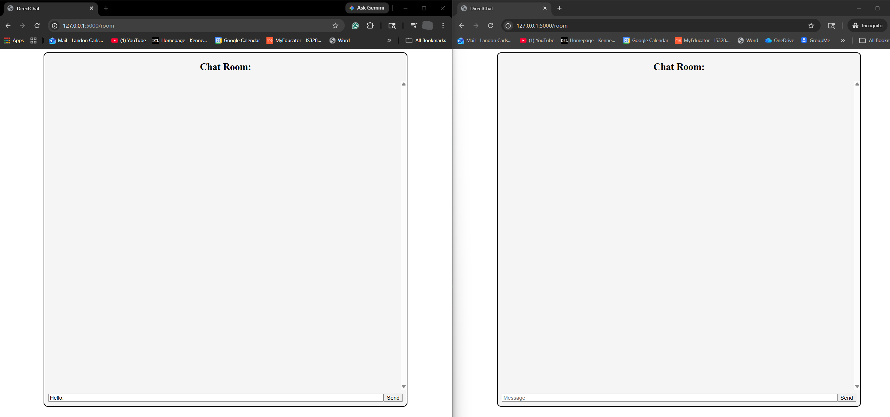
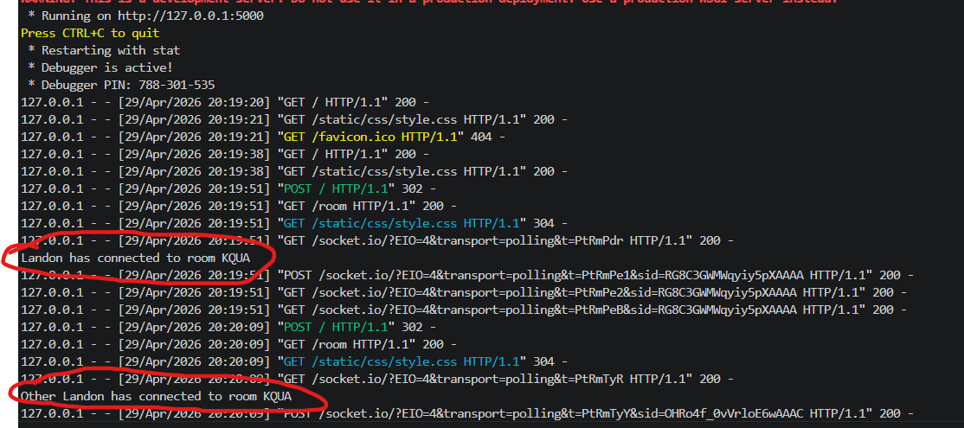
DirectChat Landon Carlson
DirectChat is a secure two-way messenger that allows two individuals to connect to a chatroom and message back and forth. The main idea was to understand and create the back-end code behind a simple messenger. So far, I am at the point where two individual tabs can be opened and can join the same chatroom. One creates the room, then the other inputs a room code to join the room. The next main step is to add the code to allow messages to be sent within the room.

